Slide 1
Information Gathering: Interactive Methods
4

Slide 2
Objectives
Recognize the value of interactive methods for information gathering.
Construct interview questions to elicit human information requirements.
Structure interviews in a way that is meaningful to users.
Write effective questions to survey users about their work.
Design and administer effective questionnaires.

Slide 3
Interactive Methods to Elicit Human Information Requirements
Interviewing
Questionnaires
Notes:
The commonality of these methods is talking with and listening to people in the organization in order to understand their interactions with technology through a series of carefully composed questions.

Slide 4
Major Topics
Interviewing
Interview preparation
Question types
Arranging questions
The interview report
Questionnaires
Writing questions
Using scales
Design
Administering

Slide 5
Interviewing
Interviewing is an important method for collecting data on human and system information requirements.
Interviews reveal information about:
Interviewee opinions
Interviewee feelings
Goals
Key HCI concerns
Notes:
Opinions – may be more revealing and more important then facts. By seeking opinion rather then fact you can discover key problems.
Feelings – You can understand the organization’s culture more fully by listening to the feelings of the respondent.
Goals – project the organization’s future. You may not be able to determine goals through any other method.
HCI – the ergonomic aspects, the system usability, how pleasing and enjoyable the system is, and how useful it is in supporting individual tasks.

Slide 6
Interview Preparation
Reading background material
Establishing interview objectives
Deciding whom to interview
Preparing the interviewee
Deciding on question types and structure
Notes:
Reading background material – read and understand as much background information about the interviewees and their organization as possible.
Corporate Web site
Current annual report
Corporate news letter
Any publication sent out to explain the organization to the public
Standard and Poor’s
Trying to build a common vocabulary to phrase interview questions and to maximize the interview time.
Establishing interview objectives – four to six key areas concerning HCI, information processing and decision-making behavior
Deciding whom to interview – Strive for balance so that as many users’ needs are addressed as possible.
Preparing the interviewee – Call ahead; keep to 45 minutes to an hour at the most.
Deciding on question types and structure – write questions to cover the key areas of decision making that you discovered when you ascertained interview objectives.

Slide 7
Question Types
Open-ended
Closed
Notes:
Each question type can accomplish something a little different from the other, and each has benefits and drawbacks.

Slide 8
Open-Ended Questions
Open-ended interview questions allow interviewees to respond how they wish, and to what length they wish.
Open-ended interview questions are appropriate when the analyst is interested in breadth and depth of reply.
Notes:
“Open” actually describes the interviewee’s options for responding. They are open.

Slide 9
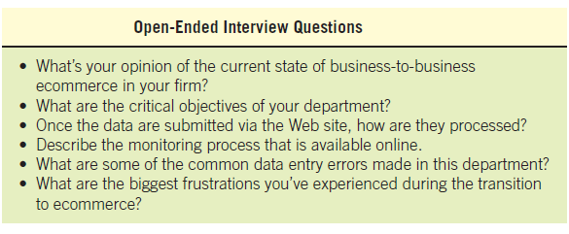
Open-Ended Questions (examples)
Notes:
“Open” actually describes the interviewee’s options for responding. They are open.

Slide 10
Advantages of Open-Ended Questions
Puts the interviewee at ease
Allows the interviewer to pick up on the interviewee’s vocabulary
Provides richness of detail
Reveals avenues of further questioning that may have gone untapped

Slide 11
Advantages of Open-Ended Questions (Continued)
Provides more interest for the interviewee
Allows more spontaneity
Makes phrasing easier for the interviewer
Useful if the interviewer is unprepared

Slide 12
Disadvantages of Open-Ended Questions
May result in too much irrelevant detail
Possibly losing control of the interview
May take too much time for the amount of useful information gained
Potentially seeming that the interviewer is unprepared
Possibly giving the impression that the interviewer is on a “fishing expedition”
Notes:
The analyst needs to carefully consider the implications of using open-ended questions for interviewing.

Slide 13
Closed Interview Questions
Closed interview questions limit the number of possible responses.
Closed interview questions are appropriate for generating precise, reliable data that is easy to analyze.
The methodology is efficient, and it requires little skill for interviewers to administer.
Notes:
The alternative to open-ended questions.

Slide 14
Benefits of Closed Interview Questions
Saving interview time
Easily comparing interviews
Getting to the point
Keeping control of the interview
Covering a large area quickly
Getting to relevant data

Slide 15
Disadvantages of Closed Interview Questions
Boring for the interviewee
Failure to obtain rich detailing
Missing main ideas
Failing to build rapport between interviewer and interviewee
Notes:
As the interviewer you must think carefully about the question types you will use.

Slide 16
Attributes of Open-Ended and Closed Questions (Figure 4.5)
Notes:
Choosing one question type over the other involves a trade-off; although an open-ended question affords breath and depth of reply, responses to open-ended questions are difficult to analyze.

Slide 17
Bipolar Questions
Bipolar questions are those that may be answered with a “yes” or “no” or “agree” or “disagree.”
Bipolar questions should be used sparingly.
A special kind of closed question
Notes:
This type of closed question limits the interviewee even further by allowing a choice on either “pole”, such as yes or no, true or false, agree or disagree.

Slide 18
Probes
Probing questions elicit more detail about previous questions.
The purpose of probing questions is:
To get more meaning
To clarify
To draw out and expand on the interviewee’s point
May be either open-ended or closed
Notes:
Used as a follow-up question.
The strongest probe is simply - Why?
It is essential to probe so that we don’t accept superficial answers.

Slide 19
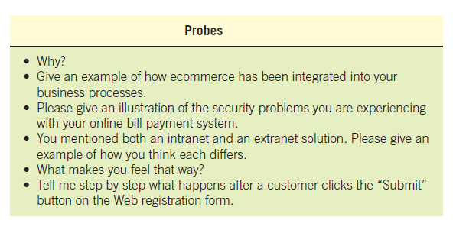
Probes

Slide 20
Arranging Questions
Pyramid
Starting with closed questions and working toward open-ended questions
Funnel
Starting with open-ended questions and working toward closed questions
Diamond
Starting with closed, moving toward open-ended, and ending with closed questions
Notes:
There are two ways of organizing interviews – Pyramid and Funnel, the diamond approach combines both.

Slide 21
Pyramid Structure
Begins with very detailed, often closed questions
Expands by allowing open-ended questions and more generalized responses
Is useful if interviewees need to be warmed up to the topic or seem reluctant to address the topic
Notes:
Inductive organization of interview questions.
Also useful if you want an ending determination about the topic.

Slide 22
Pyramid Structure for Interviewing Goes from Specific to General Questions (Figure 4.7 )

Slide 23
Funnel Structure
Begins with generalized, open-ended questions
Concludes by narrowing the possible responses using closed questions
Provides an easy, nonthreatening way to begin an interview
Is useful when the interviewee feels emotionally about the topic
Notes:
Deductive organization of interview questions.

Slide 24
Funnel Structure for Interviewing Begins with Broad Questions then Funnels to Specific Questions (Figure 4.8)

Slide 25
Diamond Structure
A diamond-shaped structure begins in a very specific way.
Then more general issues are examined
Concludes with specific questions
Combines the strength of both the pyramid and funnel structures
Takes longer than the other structures
Notes:
The diamond structure combines the strengths of the pyramid and funnel approach but has the disadvantage of taking longer.

Slide 26
Diamond-Shaped Structure for Interviewing Combines the Pyramid and Funnel Structures (Figure 4.9)

Slide 27
Closing the Interview
Always ask “Is there anything else that you would like to add?”
Summarize and provide feedback on your impressions.
Ask whom you should talk with next.
Set up any future appointments.
Thank them for their time and shake hands.
Notes:
“Is there anything else that you would like to add?” – considered a formula question the response will often be “No.”
In form the interviewee about the next steps to take.
Always remember to thank the interviewee for their time.

Slide 28
Interview Report
Write as soon as possible after the interview.
Provide an initial summary, then more detail.
Review the report with the respondent.
Notes:
The longer you wait to write your report, the more suspect your data becomes.
Review the report with the respondent – this helps clarify the meaning the interviewee had in mind and lets the interviewee know that you care.

Slide 29
Questionnaires
Questionnaires are useful in gathering information from key organization members about:
Attitudes
Beliefs
Behaviors
Characteristics
Notes:
Attributes – what people in the organization say they want.
Beliefs – what people think is actually true.
Behavior – what organizational members do.
Characteristics – properties of people or things.

Slide 30
Planning for the Use of Questionnaires
Organization members are widely dispersed.
Many members are involved with the project.
Exploratory work is needed.
Problem solving prior to interviews is necessary.

Slide 31
Question Types
Questions are designed as either:
Open-ended
Try to anticipate the response you will get.
Well suited for getting opinions.
Closed
Use when all the options may be listed.
When the options are mutually exclusive.
Notes:
Even when you write an open-ended question, it must be narrow enough to guide respondents to answer in a specific way.
Use open-ended questions when it is impossible to list effectively all possible responses to a question.

Slide 32
Tradeoffs between the Use of Open-Ended and Closed Questions on Questionnaires (Figure 4.12)

Slide 33
Questionnaire Language
Simple
Specific
Short
Not patronizing
Free of bias
Addressed to those who are knowledgeable
Technically accurate
Appropriate for the reading level of the respondent
Notes:
Write questionnaires in the respondents own language usage.
Simple – Use the language of the respondents whenever possible.
Specific – work at being specific rather then vague in wording.
Short – keep questions short
Not patronizing – do not talk down to participants through low-level language choices.
Free of bias – also means avoiding objectionable questions.
Addressed to those who are knowledgeable – target questions to correct respondents.

Slide 34
Measurement Scales
The two different forms of measurement scales are:
Nominal
Interval
Notes:
Scaling is the process of assigning numbers or other symbols to an attribute or characteristic for the purpose of measuring that attribute or characteristic.

Slide 35
Nominal Scales
Nominal scales are used to classify things.
It is the weakest form of measurement
Data may be totaled
What type of software do you use the most?
1 = Word Processor
2 = Spreadsheet
3 = Database
4 = An Email Program

Slide 36
Interval Scales
An interval scale is used when the intervals are equal.
There is no absolute zero.
Examples of interval scales include the Fahrenheit or Centigrade scale
How useful is the support given by the Technical Support Group?
NOT USEFUL EXTREMELY
AT ALL USEFUL
1 2 3 4 5
Notes:
More complete analysis can be performed on interval scales.

Slide 37
Validity And Reliability
Reliability of scales refers to consistency in response—getting the same results if the same questionnaire was administered again under the same conditions.
Validity is the degree to which the question measures what the analyst intends to measure.
Notes:
Questionnaires must be valid and reliable.

Slide 38
Designing the Questionnaire
Allow ample white space.
Allow ample space to write or type in responses.
Make it easy for respondents to clearly mark their answers.
Be consistent in style.
Notes:
A well designed, relevant questionnaire can help overcome some of this resistance to respond.

Slide 39
Order of Questions
Place most important questions first.
Cluster items of similar content together.
Introduce less controversial questions first.
Notes:
You want respondents to feel as unthreatened by and interested in the questions being asked as possible, without getting overwrought about a particular issue.

Slide 40
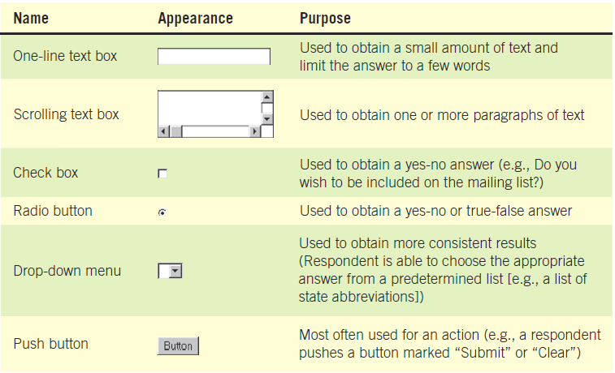
When Designing a Web Survey, Keep in Mind that There Are Different Ways to Capture Responses (Figure 4.13)
Notes:
When you design questionnaires for the Web, apply the same rules you use when designing paper questionnaires.

Slide 41
Methods of Administering the Questionnaire
Convening all concerned respondents together at one time
Personally administering the questionnaire
Allowing respondents to self-administer the questionnaire
Mailing questionnaires
Administering over the Web or via email
Notes:
The choice of administering the questionnaire may be determined by the existing business situation.
Both email and Web surveys are Self–administered; response are a little lower then other methods, but may result in less guarded answers.

Slide 42
Electronically Submitting Questionnaires
Reduced costs
Collecting and storing the results electronically
Notes:
Reminders can be sent.

